Slide 1
Verifying the Suspicious Port in Case of
Abnormal Behavior in SDN
Research Project
Mamdouh.muhammad@tu-ilmenau.de
Abdullah.Alshraa@tu-ilmenau.de

Slide 2
Outline
Software-Defined Networking (SDN)
Denial Of Service attack
Entropy-Based Solution
New Challenges
Steps
Scenarios proposed
Conclusion and future work
References

Slide 3
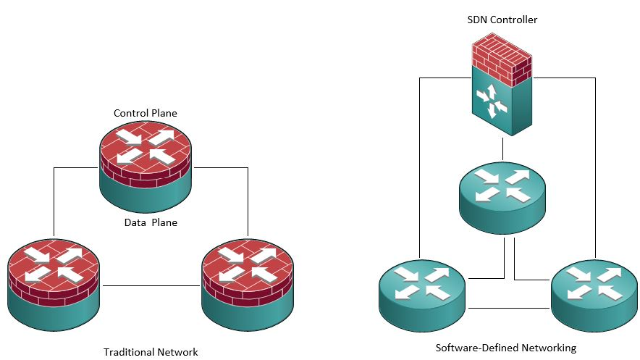
Software-Defined Networking (SDN)
Data (forwarding) plane and control plane
Centralization of control • Ease automation
Standard APIs • Reducing dependency on vendors

Slide 4
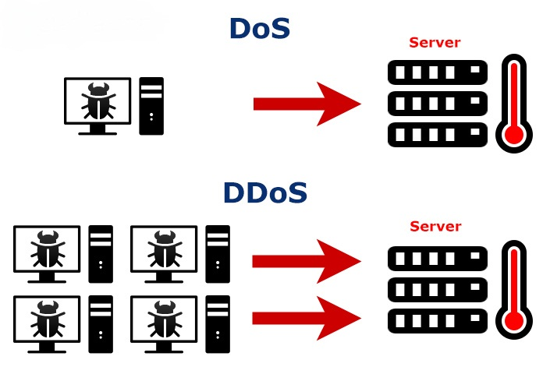
Denial of Service (DOS) Attack
Spoofed packets
Availability of a device or a server (e.g. Website)
UDP Flood
SYN Flood
DNS Reflection
HTTP Flood
ICMP Flood

Slide 5

Entropy-Based Solution
Randomness
Parameters to consider
W = {$X_{1},$ $X_{2},$ $X_{3}$ …… $X_{n}$}
$P_{i}$ = $\frac{X_{i}}{n}$
H = - $\sum_{i=1}^{n}{P_{i}}$ log $P_{i}$
Window Size
Threshold

Slide 6
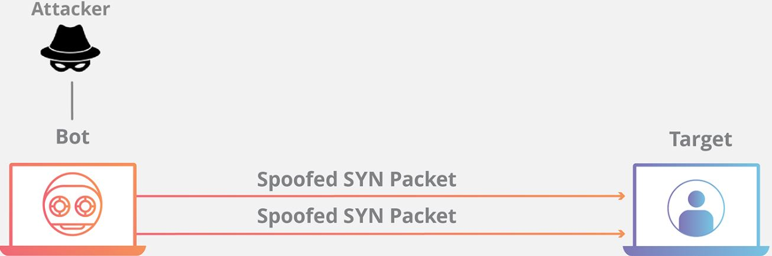
New Challenges
Other way to filter data
IPv4/v6 address
MAC address

Slide 7
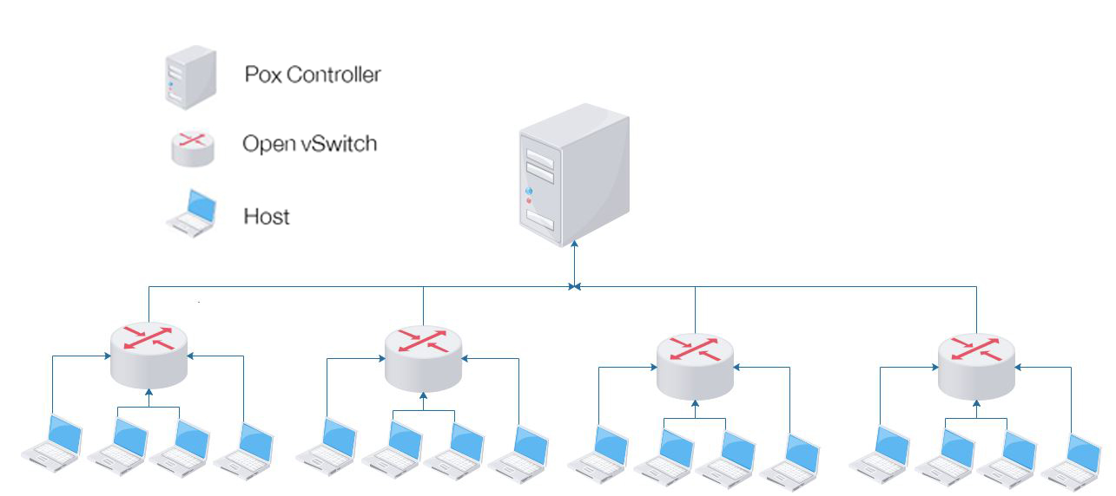
Steps:
Propose possible scenarios
Detect attack
Mitigate attack

Slide 8
Scenarios proposed:
1
Scenario 1: Benign traffic
2
3
Scenario 3: Benign+Attack Traffic
4
Mitigate the attack (Limit link BW)
Scenario 2: Attack traffic

Slide 9
Conclusion
SDN and Dos attacks challenges
Solutions to detect attacks
Challenges of proposed solutions
Future work
Machine Learning approaches
Flash crowd detect
Attacks on controller

Slide 10
References
1- L. Li, J. Zhou, and N. Xiao, “Ddos attack detection algorithms based on entropy computing,” in Information and Communications Security,
S. Qing, H. Imai, and G. Wang, Eds. Berlin, Heidelberg: Springer Berlin Heidelberg, 2007, pp. 452–466.
2- S. M. Mousavi and M. St-Hilaire, “Early detection of ddos attacks against sdn controllers,” in 2015 International Conference on Computing, Networking and Communications (ICNC), Feb 2015, pp. 77–81.
3- Mauro Conti, Chhagan Lal, Reza Mohammadi & Umashankar Rawat Lightweight solutions to counter DDoS attacks in software defined networking
4- Maryam Kia, Early Detection and Mitigation of DDoS Attacks In Software Defined Networks, Feb 2015
5- Mahmood Z. Abdullah, Nasir A. Al-awad, Fatima W. Hussein, Implementation of Entropy-based Distributed Denial of Service Attack Detection Method in Multiple POX Controllers, June 2019
6-Raouia Taktak Lamia Chaariand Bernard Cousin Ri-hab Maaloul. “Energy-Aware Routing in Carrier-GradeEthernet using SDN Approach”. In: (2017).
7-https://anydifferencebetween.com/difference-between-ddos-and-dos/
8- https://www.cloudflare.com/learning/ddos/what-is-a-ddos-attack/

Slide 11
Thanks

Slide 12
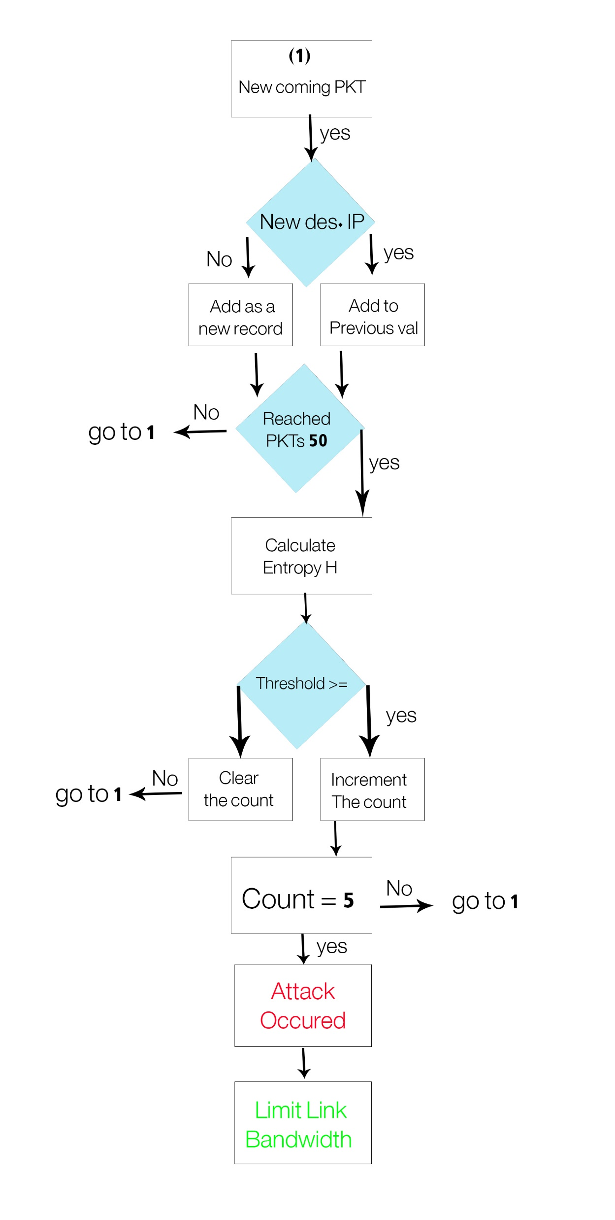

Slide 13
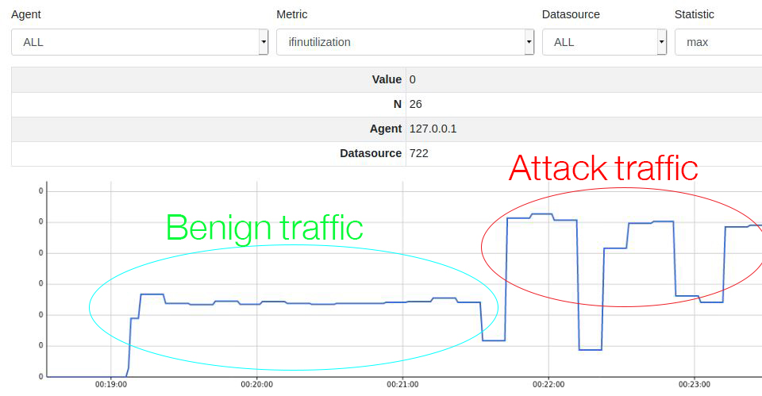

Slide 14
